Slide 1
Screen Time Analysis Project
Name: D Naveen Kumar Reddy
Department : MCA (VTU) Semester:Third
USN: 1BO23MC007

Slide 2
Outline
Title Name
Outline
Abstract
Problem Statement
Proposed Solution
Short Video
Implementation
Output Screenshots
References

Slide 3
Abstract:
In the modern digital age, screen time management has become a critical aspect of maintaining physical and mental well-being. Excessive use of digital devices can lead to issues such as eye strain, disrupted sleep cycles, and a sedentary lifestyle. However, many individuals are unaware of the time they spend on screens or the types of activities that consume their time. This project aims to develop a Screen Time Analysis Tool that helps users track and analyze their screen usage across multiple devices and applications. The tool provides detailed reports and visualizations, helping users make informed decisions about their digital habits. The project leverages Python for data processing and visualization, incorporating libraries such as Pandas, Matplotlib, and Plotly for insightful analytics.

Slide 4
Problem Statement
With the rise of digital devices and applications, people often find themselves spending significant amounts of time on screens, which can lead to health issues such as eye strain, disrupted sleep, and a sedentary lifestyle. However, many individuals are unaware of how much time they spend on various applications and devices. This lack of awareness makes it difficult to adopt healthier digital habits and maintain a proper work-life balance.

Slide 5
Proposed Solution
The solution to this problem is to build a Screen Time Analysis application that tracks and visualizes the time users spend on their devices, across different apps, and even provides insights into usage trends. The app will:
Track screen time: Automatically monitor and log screen time for different devices (smartphones, laptops, tablets).
Categorize usage: Break down screen time by application, categorizing them into work, social media, entertainment, etc.
Provide insights: Offer detailed reports and analytics, such as daily, weekly, or monthly trends.
Set goals: Allow users to set time limits for specific apps or total screen time per day.
Notifications and alerts: Send reminders or warnings when users exceed their set limits.
Visualization: Provide charts and graphs (using tools like Plotly or Matplotlib) to make the data easier to interpret.

Slide 6
Implementation
https://github.co/Priya010H/Netflix-Analysis-

Slide 7
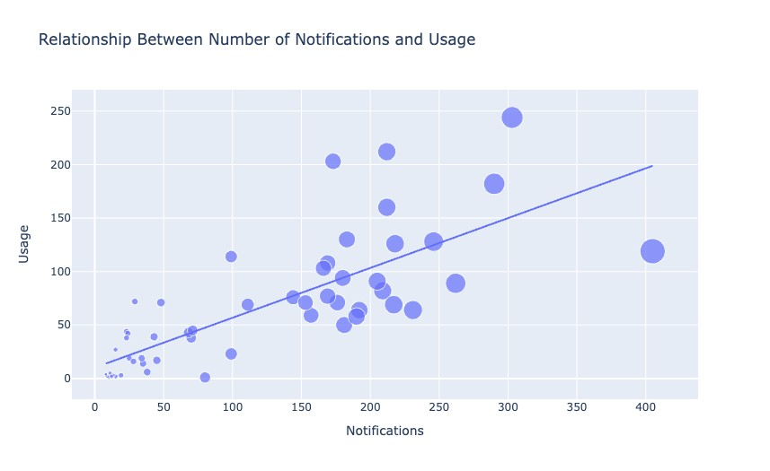
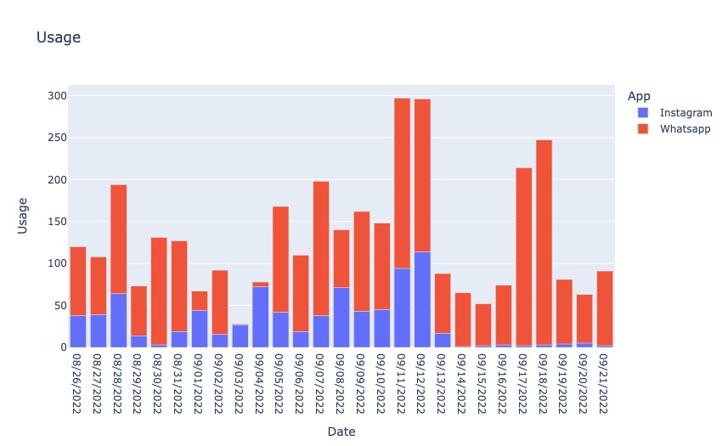
Output

